Slide 1
Software Quality Assurance
Pavithra Subashini
Senior lecturer
Faculty of Computing

Slide 2
Psychology of testing

Slide 3
Why test?
build confidence
prove that the software is correct
demonstrate conformance to requirements
find faults
reduce costs
show system meets user needs
assess the software quality

Slide 4
Confidence
Confidence
Fault found
Faults found
Time
No faults found = confidence?

Slide 5
A traditional testing approach
Show that the system:
does what it should
doesn't do what it shouldn't
Goal: show working
Success: system works
Fastest achievement: easy test cases
Result: faults left in

Slide 6
A better testing approach
Show that the system:
does what it shouldn't
doesn't do what it should
Goal: find faults
Success: system fails
Fastest achievement: difficult test cases
Result: fewer faults left in

Slide 7

The testing paradox
Finding faults destroys confidence
Purpose of testing: to find faults
Purpose of testing: build confidence
The best way to build confidence
is to try to destroy it

Slide 8
Who wants to be a tester?
A critical process
Bring bad news (“your baby is ugly”)
Under worst time pressure (at the end)
Need to take a different view, a different mindset (“What if it isn’t?”, “What could go wrong?”)
How should fault information be communicated (to authors and managers?)

Slide 9
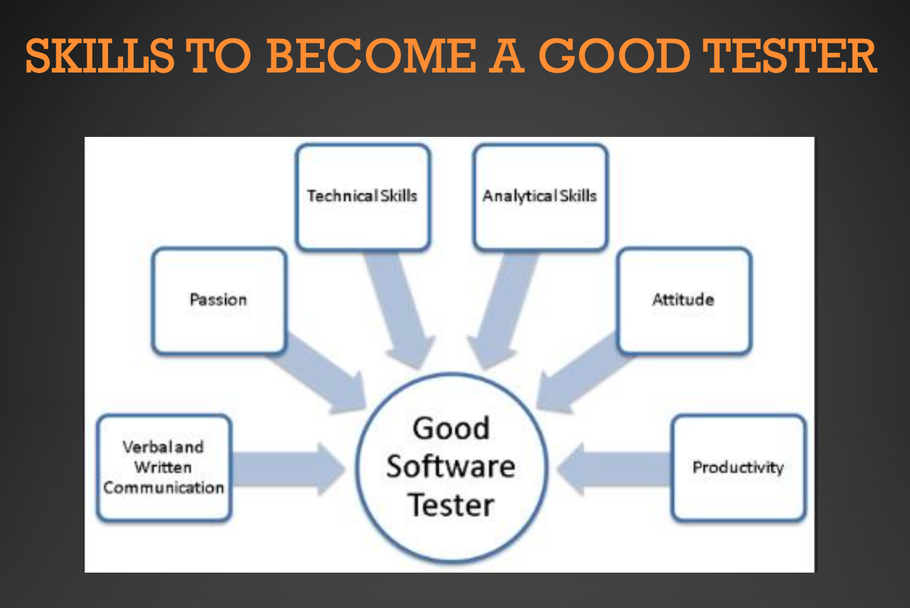

Slide 10
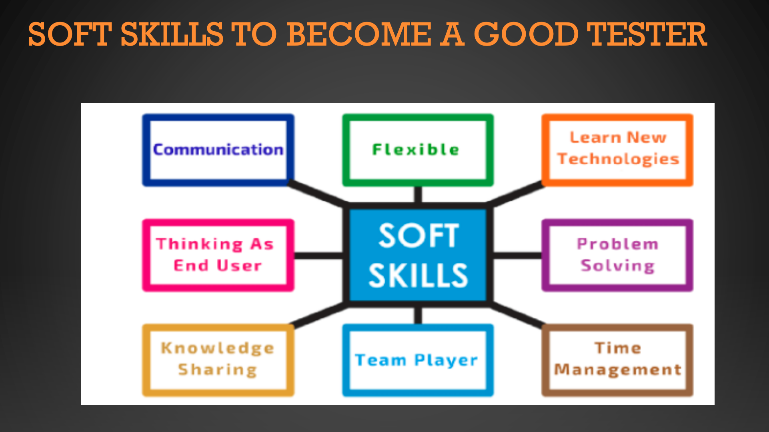

Slide 11
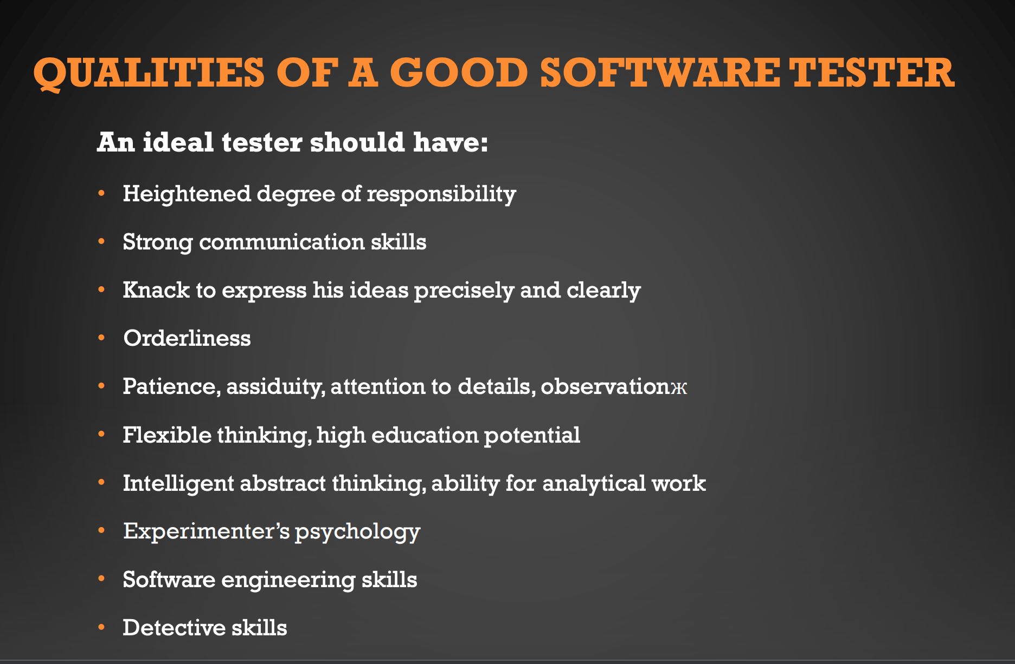

Slide 12
Tester’s have the right to:
Accurate information about progress and changes
Insight from developers about areas of the software
Delivered code tested to an agreed standard
Be regarded as a professional (no abuse!)
Find faults!
Challenge specifications and test plans
Have reported faults taken seriously (non-reproducible)
Make predictions about future fault levels
Improve your own testing process

Slide 13
Testers have responsibility to:
Follow the test plans, scripts etc. as documented
Report faults objectively and factually (no abuse!)
Check tests are correct before reporting s/w faults
Remember it is the software, not the programmer, that you are testing
Assess risk objectively
Prioritise what you report
Communicate the truth

Slide 14
Independence
Test your own work?
find 30% - 50% of your own faults
same assumptions and thought processes
see what you meant or want to see, not what is there
emotional attachment
don’t want to find faults
actively want NOT to find faults

Slide 15
Levels of independence
None: tests designed by the person who wrote the software
Tests designed by a different person
Tests designed by someone from a different department or team (e.g. test team)
Tests designed by someone from a different organisation (e.g. agency)
Tests generated by a tool (low quality tests?)

Slide 16



